Slide 1
CSE308:COMPUTING PRACTICUM-IV
Unit 5: Managing SELinux Security
• Changing the SELinux Enforcement Mode
• Controlling SELinux File Contexts
• Adjusting SELinux Policy with Booleans
• Investing and Resolving SELinux Issues
Outcome: Apply ACLs on files and enhance system security using SELinux

Slide 2
Security Enhanced Linux
Chmod for file permissions
ACL is for goups and users at micro level
SELinux to protect system and also tells the file and directory have to access which port
Here it also decides that whether a process can access file directory or port
If two files and directories have same permissions then we cant say that both can do the same function. It depends on their SELinux context.
Here it is a talk of processes and services not users

Slide 3
SELinux Security
ls
ls –l
ls –Z related with SELinux
ls –Z /var (displays all file and directories in long listed format)
Few files are related to ftp, tmp,var.
Ps –ef(display all processes which are running in the machine)
Ps –efz (display context of processes also)
Systemctl start httpd.service
Ps –efz| grep http (to check for http only)

Slide 4
SELinux Modes
Semanage port|grep http (to get only port numbers related with http)
SELinux modes
Enforcing (restrict if something is not allowed as per the policy)
Permissive (monitoring)
Diabled (totally disabled)
Getenforce (to check for current mode of SELinux)
Setenforce 1 or 0 ( I enforcing 0 permissive)

Slide 5
SELinux Modes
Getenforce (to check the current mode)
Setenforce 0 (change the mode to permissive)
Setenforce 1( change the mode to enforcing)
To Disable :- edit the config file
Vim /etc/sysconfig/selinux
And change the mode to disable and reboot the system

Slide 6
SELinux Booleans
Ensure that httpd is able to access the user home directory.
Here we have to change the Boolean value from off to on
Getsebool –a (will give you list of all the Booleans)
Getsebool –a| grep “httpd” (check here for home directory)
Search for the homedir whether it isenable or not

Slide 7
SELinux Booleans
Setsebool –P httpd_enable_homedirs on
Getsebool –a| grep “httpd” (check here for home directory)

Slide 8
SELinux Ports
semanage port –l (display all port numbers along with their context)
semanage port –a –t http_port_t –p tcp 82(to change the port to 82 for httpd)
Again you can go for { semanage port –l} and check whether the port 82 is added to list or not.

Slide 9
SELinux Questions
Raju wants to change the mode from its current to other. What he has to do for the same?
Sumit is not happy with any mode. He just want to disable the mode. Do as he want.
Ensure that httpd is able to access the user home directory.(Boolean )

Slide 10
SELinux Security
Example of apache web server(httpd)
Ls –l /var/www/html
Create a file in this directory named as file1.html
Check for its permissions
Check for the permissions of the same html directory

Slide 11
SELinux Security
Create a directory in the root as new
mkdir /new
Create a file name file in this new directory
touch /new/index
Check for the permissions of new directory and file
ls –ld /new
ls –l /new/index

Slide 12
SELinux Security
Now write some content in file1.html
And host it by using apache web server
go to /etc/httpd/conf/httpd.conf
And check this document that DocumentRoot “/var/www/html”
Your https services must be running
Then host it by using curl localhost/file1.html
And you will get the output

Slide 13
SELinux Security
Again go to /etc/httpd/conf/httpd.conf
And check this document that DocumentRoot “/var/www/html”
And add there DocumentRoot “/new/file
Then restart the service because we are changing in the config files
Systemctl restart httpd
Add content in the file1
And now try to host this file1
You will get the error and page is not going to be hosted

Slide 14
SELinux Security
Ls –lZ /var/www/html/index.html (it will show you the context of the file)
You will get httpd sys content
Check for Ls –lZ /new/file1 (it will show you the context of the file)
Here no policy of httpd

Slide 15
SELinux Security
We can change the context of the directory new which contains file1
Semanage fcontext –a –t httpd_sys_content_t “/new(.*)?”
Then
Restorecon –Rv /new
And if it is successful then you can host this because content for the same is changed.

Slide 16


Slide 17
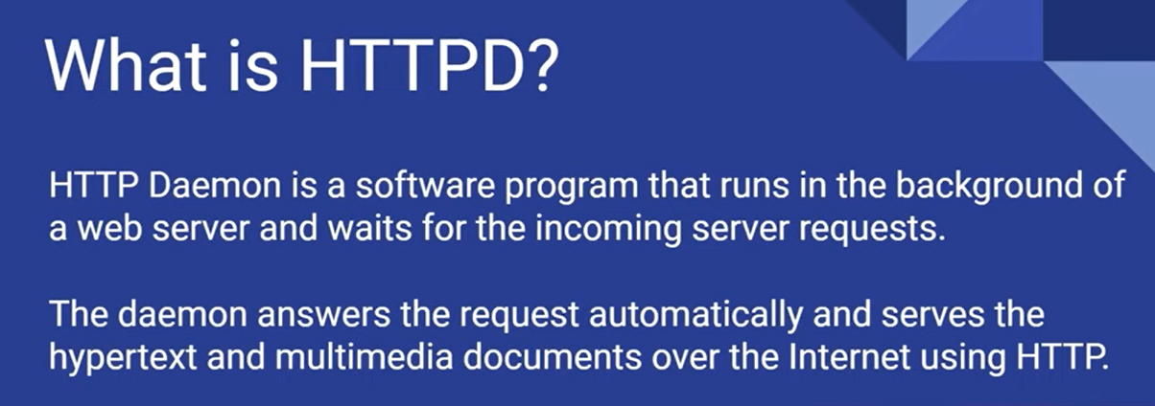

Slide 18
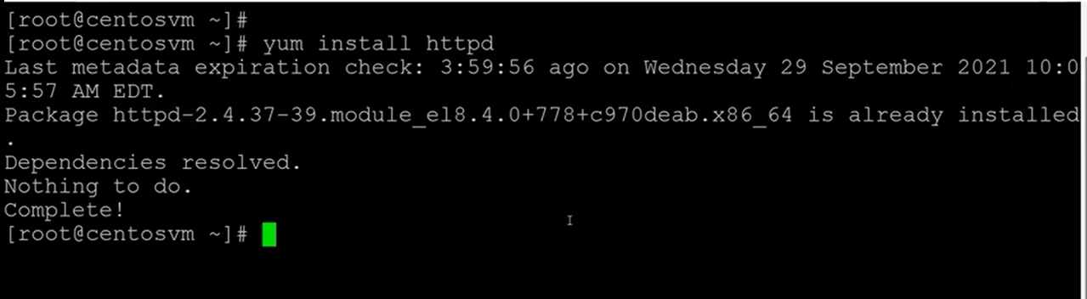
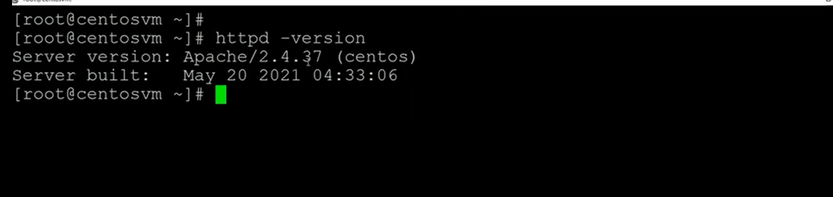

Slide 19
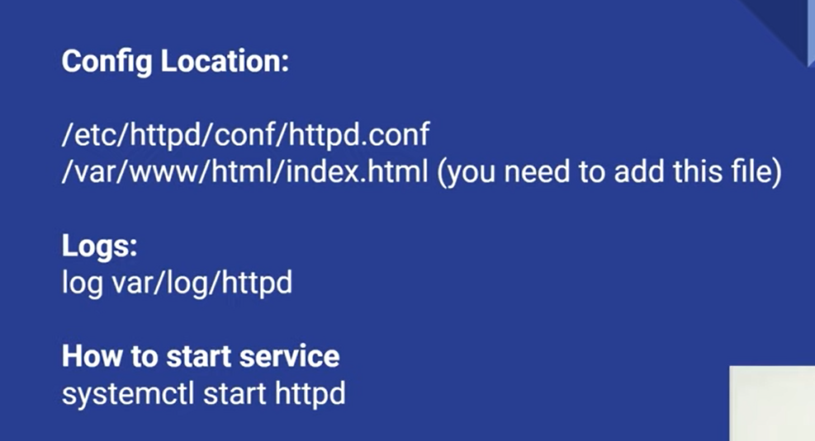

Slide 20
Apache Web Server- Httpd
Go to cd /etc/httpd/conf
ls and open
less httpd.confg (Read the document)
Cd /var/www/html (enter into this and create html files
Vi index.html
Add html file and host it

Slide 21
Apache Web Server- Httpd
Check fot httpd status
Systectl start httpd
Ip addr
Paste the ip in web browser and check
Then disable firewall

Slide 22
Apache Web Server- Httpd
Systemctl stop firewalld.services
And then check by again run into the browser

